Slide 1
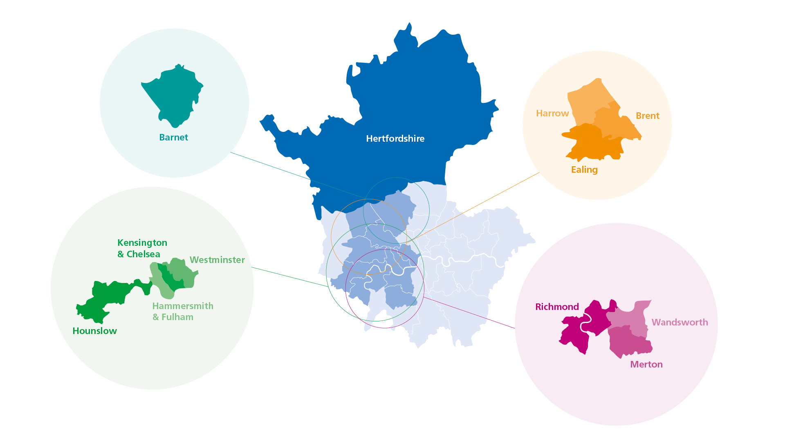
CQC inspection - identified actions update
CLCH Community Nursing (Harrow)

Slide 2
Recap: Inspection
19-26 October 2022
Community Nursing teams in Harrow (all 3 localities)
Focused inspection on the ‘Safe’ domain
Reviewed improvements implemented since 2021
Visited two major staff bases
Included Harrow Tissue Viability, Podiatry and Rapid Response services

Slide 3
Recap: Improvements identified
CQC identified x3 actions the Trust ‘should do’ to improve
CQC identified x2 actions the Trust ‘must do’* to improve
Action plans created to achieve the improvements required
*requirement notices
Must Do | Should Do
ensure that robust processes and systems are in place to safely meet the needs of the patients | ensure that all handovers include all necessary key information to keep patients safe.
ensure that clinical documentation is completed in sufficient detail in the Harrow community nursing teams | ensure that formal assessments of patients capacity are appropriately recorded.
 | ensure staff report safeguarding concerns to the local authority when they are required to do so.

Slide 4
Key work undertaken
Processes and procedures reviewed, created or updated to ensure provision of safe, effective and consistent quality care
Engagement with other providers to share learning
Significant engagement with workforce to ensure understanding of operational and regulatory requirements
Redistributed caseload to reduce travel and increase capacity
Upskilled junior staff to i) provide experience, and ii) increase capacity of senior staff to provide more complex care
Introduction of clinical triage function
Extensive recruitment campaign to fill vacancies

Slide 5
Key outcomes achieved
Reduction in vacancy rate - five international nurses joined the service in 2023 (to date)
Establishment of clinical triage post to promptly and robustly address the needs of patients being referred into the service
Re-development of shadow visit process for assurance of high quality patient facing activities
Creation of two fixed term quality posts which successfully implemented and managed induction processes around training and competence and increased existing staff support
Formalised daily handover process implemented - overseen by managers for assurance and scrutiny
Staff survey captured level of confidence in undertaking mental health capacity assessments and reporting safeguarding concerns to the local authority - used to inform new training content and processes (work underway)

Slide 6
Next steps
External audit of ‘must do’ actions being undertaken during August 2023
Audit will provide assurance to Trust executive leadership team whether improvements have been identified and implemented, or if additional areas for improvement or action are required
Create plans for any additional improvements identified
Internal peer review to gain assurance that improvements have been sufficiently embedded into practice
Lessons learned and actions undertaken anticipated to be fully embedded by Q3 2023/24

Slide 7
CLCH Outer North West Division
Jackie Allain
Acting Director of Operations
j.allain@nhs.net
Patrick Laffey
Deputy Director of Operations
patrick.laffey@nhs.net
Sam Howard
Divisional Director of Nursing & Therapies
samantha.howard@nhs.net

